Slide 1


SOCIAL MEDIA
OPSEC TRAINING
Delaware National Guard Public Affairs Team
^{Maj. Bernie Kale,}
^{Public Affairs Director}

Slide 2


SOCIAL MEDIA DO’S & DON’TS

Quick overview on policy, guidelines and recommendations for all personnel
OPERATIONS SECURITY

Social media amplifies OPSEC risks because it enables greater volume and increased speed of information shared publicly
PRIVACY TIPS

It’s essential that you learn about and use the privacy and security settings on any social media site you use.

Slide 3
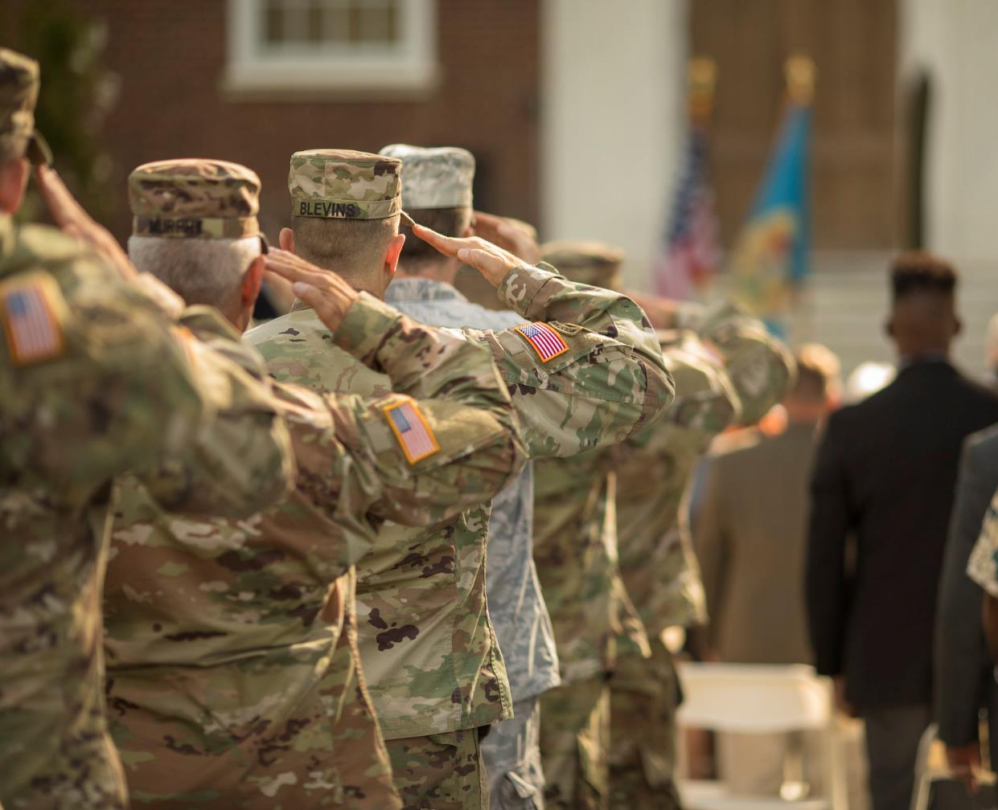
BOTTOM LINE
UP FRONT
National Guard personnel are responsible for the content they publish on social media sites, blogs and other internet-based capabilities and should ensure that this content is accurate, appropriate and does not compromise mission security or success.
All DoD personnel are responsible to adhering to regulations and policy. Violations of regulations and policies may result in disciplinary action.

Slide 4
Social Media Do’s
Limit visibility to only friends and family
Turn off location/geotagging features on cell phone before taking photos
Report suspicious activity to leadership, law enforcement, ATFP or counterintelligence entities
Review privacy settings on all social media, apps, cell phone, etc…


Slide 5
Social Media Do’s
Minimize the use of apps that automatically upload and share captured images
Ensure your family takes similar precautions
Use secure browser settings and monitor your browsing history
Carefully consider who you allow access to your social media profiles and personal information, to include Facebook, Twitter, LinkedIn, etc…


Slide 6
Social Media Don’ts
“Check-in” upon arrival at locations on social media platforms
“Friend” people you have never met
Log-in to or link third-party sites using social media/email accounts


Slide 7
Social Media Don’ts
Provide personal details regarding your whereabouts and activities in posts
Use passwords that follow a pattern or are easily guessed
NEVER disclose any information that compromises Operational Security (OPSEC) or foreign disclosure policy. NEVER disclose information that is intended for official use only (FOUO).


Slide 8
OPSEC – Do NOT post
Detailed information about the mission of assigned units
Details concerning locations and times of unit deployments (Disable Facebook Geotag)
Number of aircraft in squadron/photos of flight line showing aircraft location


Slide 9
OPSEC – Do NOT post
Details concerning trends in unit morale or personnel problems
Details concerning security procedures
Classified or controlled unclassified information (CUI)


Slide 10
OPSEC – Do NOT post
Sensitive information: tactics, troop movements, force size, weapons system details
NOTE: Many social media sites (such as Facebook, Twitter, YouTube) have policies that give them ownership of all content and information posted or stored on their systems. You may have said it, but they own it.


Slide 11
OPSEC – Safe to Post
Pride and support for service, units, specialties and service members
Generalizations about service or duty


Slide 12
OPSEC – Safe to Post
General status of the location of a unit
  YES “operating in southern Afghanistan”
  NO “operating in the village of Hajano Kali in Arghandab district ”


Slide 13
OPSEC – Safe to Post
Links to published articles about the unit or service member
Information in the public domain so long as it doesn’t violate privacy of others or doesn’t compromise operations security
NOTE: Courteous operational security reminders are OK.


Slide 14
OPSEC – Questions?
When in doubt, contact the unit operations officer, security officer, intelligence officer, or public affairs officer for guidance.


Slide 15
Privacy Tips
The advent of social media has been an amazing way to reconnect with old friends and colleagues. However, you may have also exposed yourselves to the underbelly of the internet if you have not taken the necessary steps to protect your information. Hackers, predators, and foreign state actors troll social networking sites to find vulnerable targets for exploitation.
Visit the Social Media Hub on NationalGuard.mil for tips and best practices:
www.NationalGuard/Features/Social-Media-Guidance/


Slide 16
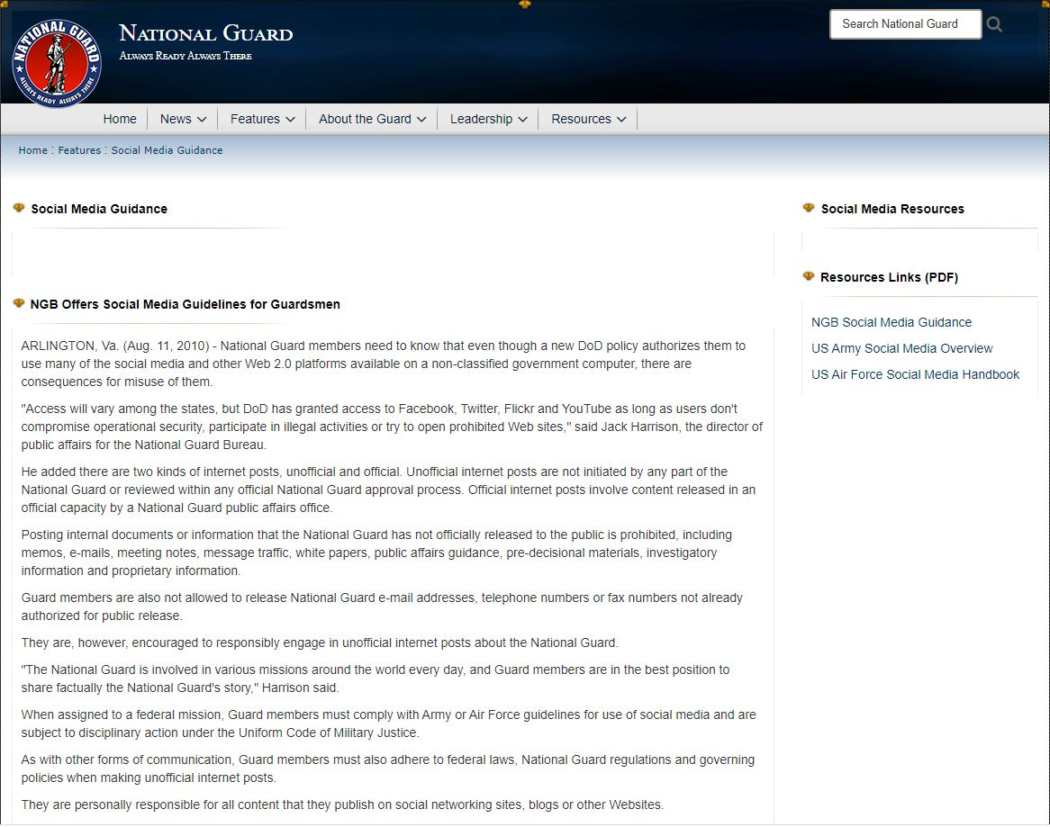
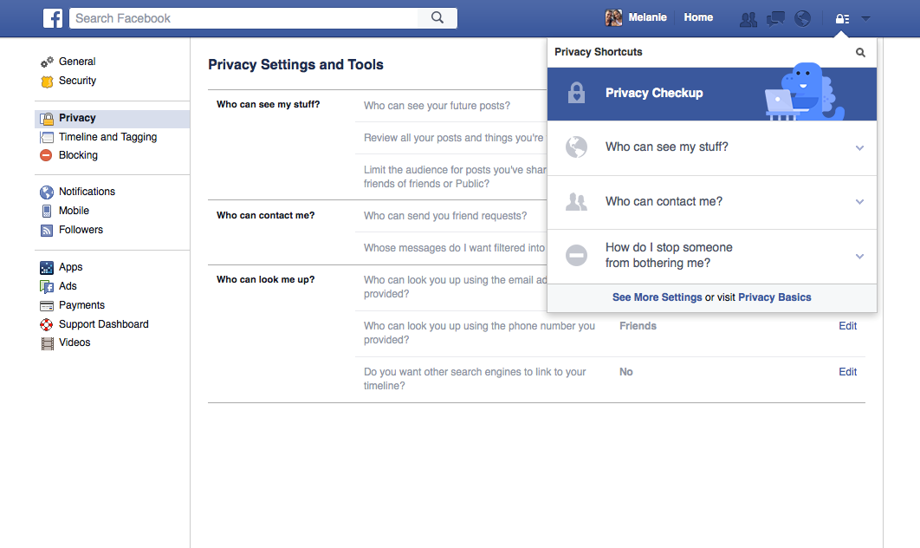

Slide 17
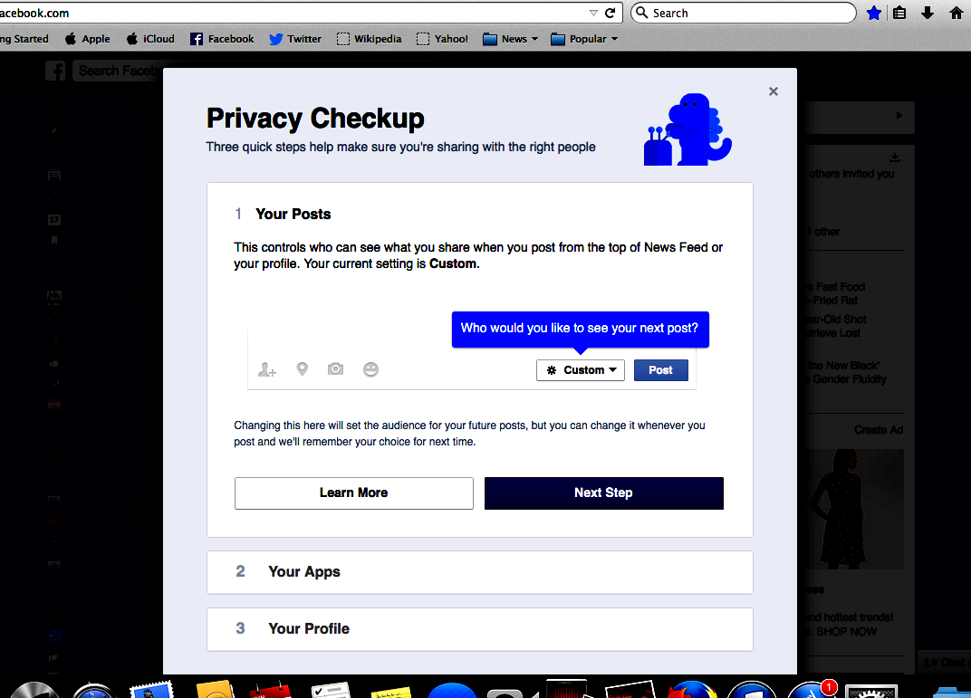


Slide 18
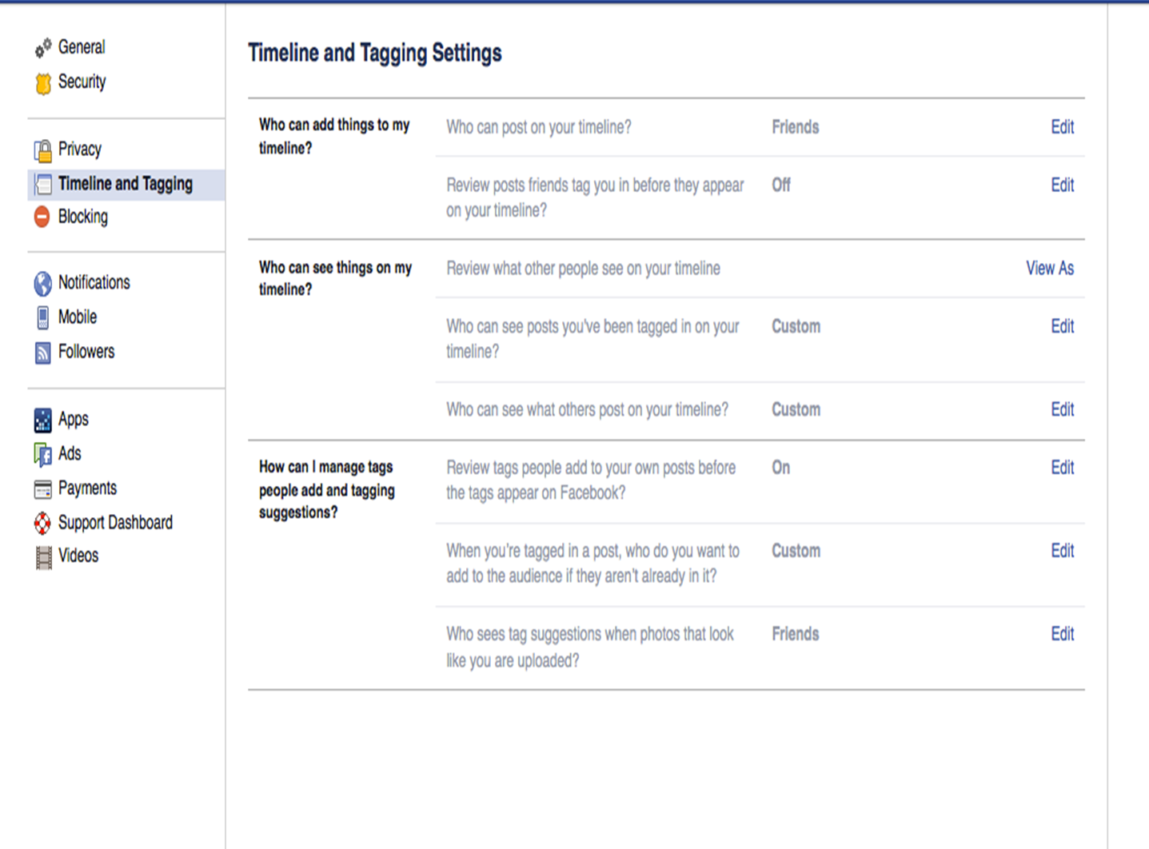
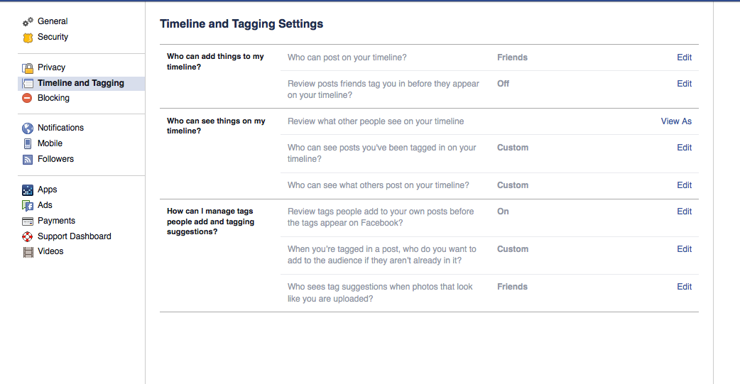

Slide 19
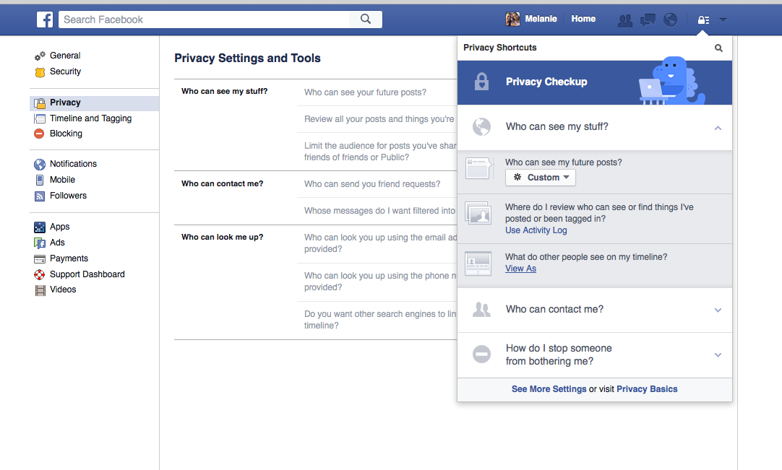

Slide 20
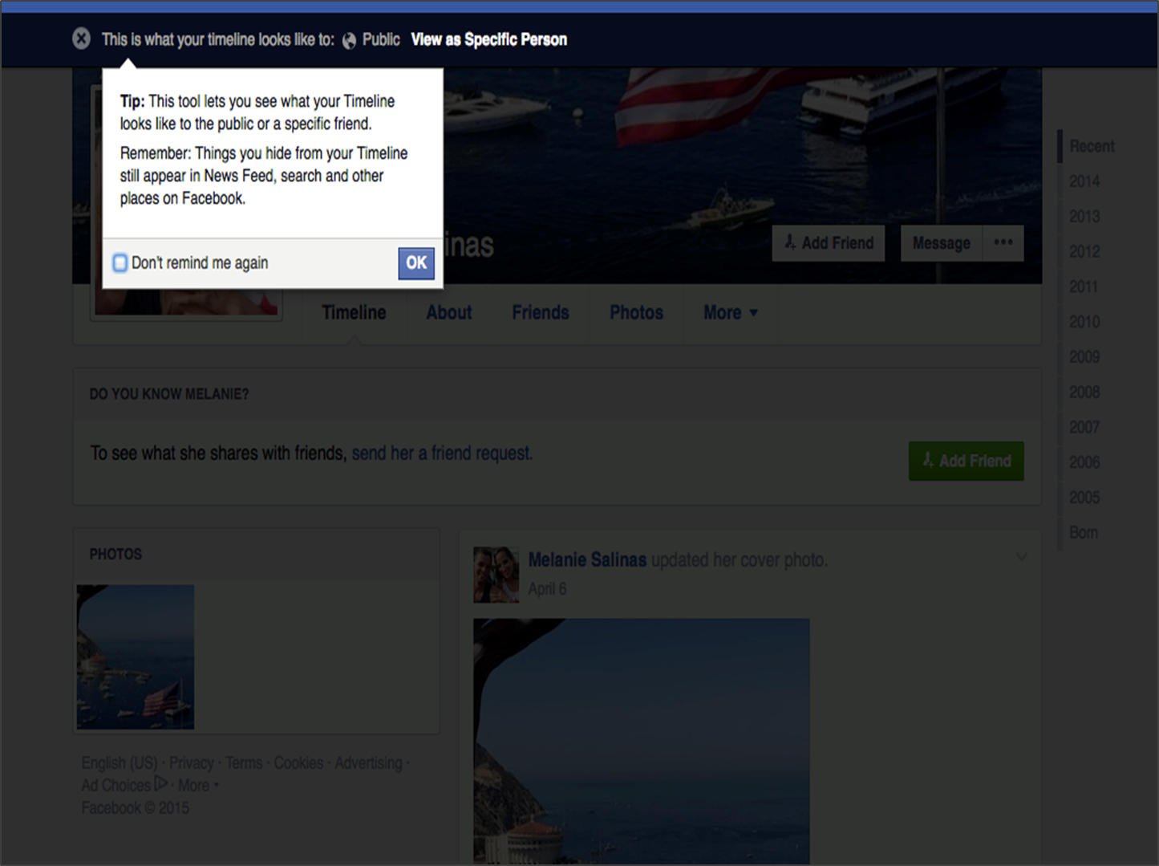
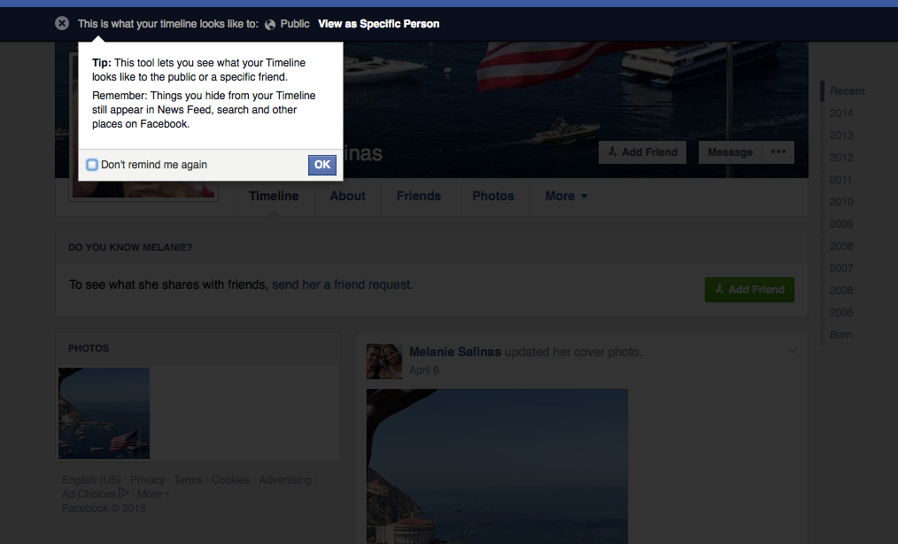

Slide 21
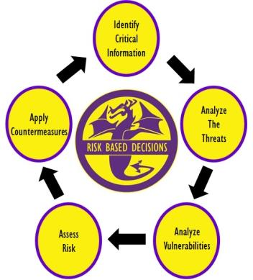
_________________
OPERATIONAL SECURITY
OPSEC is a process that identifies critical information, outlines potential threats and vulnerabilities, assesses risk, and develops counter measures to safeguard critical information
Notes:
Operations Security: 1. A systematic, proven process by which a government, organization, or individual can identify, control, and protect generally unclassified information about an operation/activity and, thus, deny or mitigate an adversary's/competitor's ability to compromise or interrupt said operation/activity (NSC 1988). 2. OPSEC is a process of identifying critical information and subsequently analyzing friendly actions attendant to military operations and other activities to (a) identify those actions that can be observed by adversary intelligence systems, (b) determine indicators adversary intelligence systems might obtain that could be interpreted or pieced together to derive critical information in time to be useful to adversaries, and select and execute measures that eliminate or reduce to an acceptable level the vulnerabilities of friendly actions to adversary exploitation (DOD JP 1994; JCS 1997).
Operations Security process: An analytical process that involves five components: identification of critical information, analysis of threats, analysis of vulnerabilities, assessment of risks, and application of appropriate countermeasures (NSC 1988).
Completing this process will allow commanders to make informed risk based decisions on what information they need to protect and how they are going to protect it.
Source: http://www.ioss.gov/glossary.html#o

Slide 22
___________________
Critical Information
  Position at work, certifications
  Physical limitations, medical information
  Family routines
  Vacation and travel itineraries
  Social security number, credit cards, banking information
  Hobbies, likes, dislikes, etc.
Information an adversary would need to do you harm that must be protected
  Names and photos of you, your family and co-workers
  Usernames, passwords, network details
  Job title, location, salary
  Home security systems, internet service provider
  What kind of pets and how many
Notes:
Critical Information (CI) as it pertains to OPSEC is detail specific, unclassified information that an adversary needs to obtain to act against an individual or unit. For example, the watch rotation of a unit, while not classified information, is vital to the security posture and is a detail that should be protected. Though it is unclassified, it is still information that you would not want to give to an adversary.
critical information: Specific facts about friendly (e.g., U.S.) intentions, capabilities, or activities vitally needed by adversaries for them to plan and act effectively so as to guarantee failure or unacceptable consequences for accomplishment of friendly objectives.
Related to Essential Elements of Friendly Information; CI is the answers to questions that make up EEFI.
Source: http://www.ioss.gov/glossary.html#c

Slide 23
___________________
Critical Information
  Position at work, certifications
  Physical limitations, medical information
  Family routines
  Vacation and travel itineraries
  Social security number, credit cards, banking information
  Hobbies, likes, dislikes, etc.
Information an adversary would need to do you harm that must be protected
  Names and photos of you, your family and co-workers
  Usernames, passwords, network details
  Job title, location, salary
  Home security systems, internet service provider
  What kind of pets and how many
Notes:
Critical Information (CI) as it pertains to OPSEC is detail specific, unclassified information that an adversary needs to obtain to act against an individual or unit. For example, the watch rotation of a unit, while not classified information, is vital to the security posture and is a detail that should be protected. Though it is unclassified, it is still information that you would not want to give to an adversary.
critical information: Specific facts about friendly (e.g., U.S.) intentions, capabilities, or activities vitally needed by adversaries for them to plan and act effectively so as to guarantee failure or unacceptable consequences for accomplishment of friendly objectives.
Related to Essential Elements of Friendly Information; CI is the answers to questions that make up EEFI.
Source: http://www.ioss.gov/glossary.html#c

Slide 24
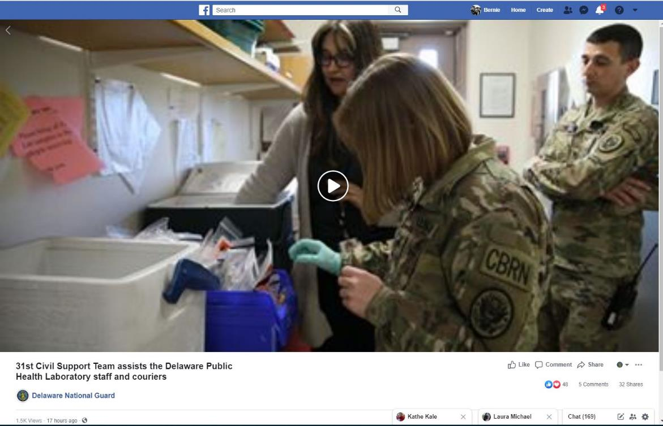
___________________
Geotagging photo/video
GPS data embedded into photos
Default feature in most smart phones and digital cameras
  Latitude/longitude
  Device information
Information can potentially be retrieved from any photo posted on the Internet
Notes:
Critical Information (CI) as it pertains to OPSEC is detail specific, unclassified information that an adversary needs to obtain to act against an individual or unit. For example, the watch rotation of a unit, while not classified information, is vital to the security posture and is a detail that should be protected. Though it is unclassified, it is still information that you would not want to give to an adversary.
critical information: Specific facts about friendly (e.g., U.S.) intentions, capabilities, or activities vitally needed by adversaries for them to plan and act effectively so as to guarantee failure or unacceptable consequences for accomplishment of friendly objectives.
Related to Essential Elements of Friendly Information; CI is the answers to questions that make up EEFI.
Source: http://www.ioss.gov/glossary.html#c

Slide 25
















SOCIAL MEDIA IS A TOOL: Neither good nor bad
Social Media Sites allow people to network, interact and collaborate to share information, data and ideas without geographic boundaries
Notes:
There is an ever growing list of SNS that connect users in ways they would have never imagined. Because of SNS we are able to communicate with friend and family that would have otherwise been more distant. SNS provide a great benefit that can enhance our lives. However, we have to be aware of the dangers of SNS.

Slide 26
Questions?
Feedback?
Reminder:
To the American public, you are the National Guard. To the world, you are the United States.
.

